Slide 1
Financial literacy
Presented By
Arif Aggarwal

Slide 2
CONTENTS
INTRODUCTION
WHERE DOES YOUR MONEY COME FROM?
WHERE DOES YOUR MONEY GO?
FINANCIAL PLANNING
INVESTMENT
SIMPLE WAYS OF INVESTMENT

Slide 3
INTRODUCTION
Financial literacy refers to the ability to understand and apply different financial skills effectively, including personal financial management, budgeting , saving and investing.
Financial literacy makes individuals become self-sufficient, so that financial stability can be accomplished.

Slide 4


WHERE DOES your MONEY COME FROM?
Cashflow Quadrant(Four ways that money may come your way)
RAT RACE
FAST TRACK

Slide 5
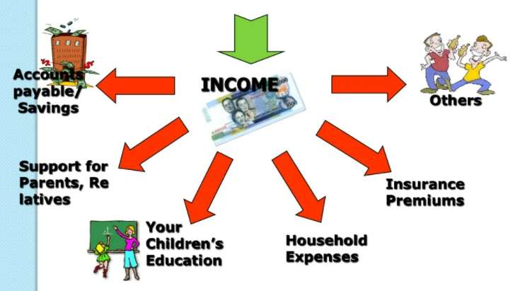
WHERE DOES YOUR MONEY GO ?

Slide 6
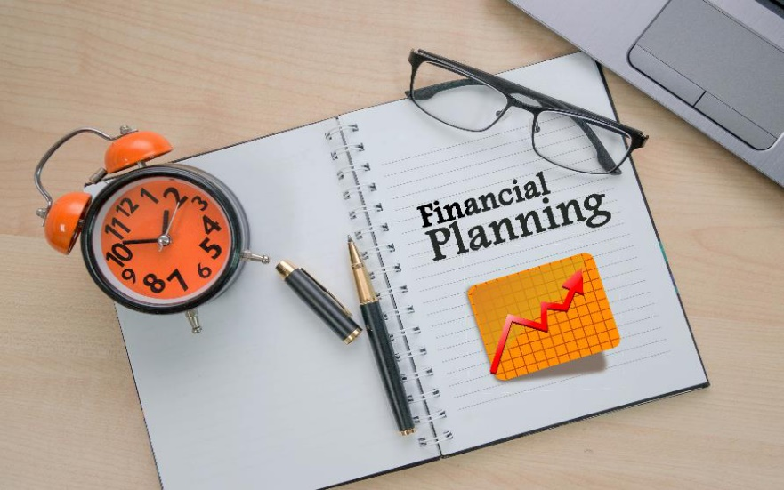
FINANCIAL PLANNING
BENEFITS OF HAVING A FINANCIAL PLAN:-
It can help you avoid mistakes/sidetrack
Helps You make smarter
Can insulate you from the turbulence in the economy
Makes money work for you!

Slide 7
INVESTMENT
Investment is the commitment of funds made in expectation of some positive rate of return.
Invest and Diversify Invest
Make your money grow . Invest your savings in money making-assets.
Make Your Money Work For You

Slide 8
simple ways of investment
Invest in debt
Lending Investments : A bond issued by a company or a government will pay a set amount of interest over a set period of time.
Real Estate: Real estate investing refers to the purchase of property as an investment to generate income rather than using it as a primary residence
Stock Market: When you invest in stocks you are putting that capital to work under the supervision of a firm and its management team. Although there is some risk, that risk is rewarded with a positive expected return in the form of capital gains and/or dividend & interest flows.

Slide 9
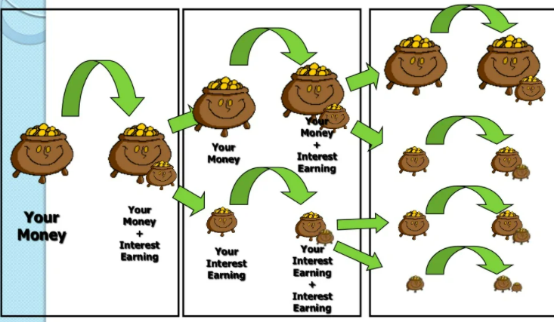
Trust the power of time AND COMPOUNDING
PERIOD 1
PERIOD 2
PERIOD 3

Slide 10
CONCLUSION
College graduates spent 16 years gaining skills that will help them command a higher salary , yet little or no time is spent helping them save, invest and grow their money. Surveys tell that only 24% of Indians are financially literate. We need to increase the percentage as financial skills will help to raise the standard of living and contribute to overall growth of economy.

Slide 11


Slide 12
references
RICH DAD’S CASHFLOW QUADRANT BY ROBERT T. KIYOSKI
cleartax.in
www.slideshare.net

Slide 13
Thank you

